Slide 1



ADVENTUREBOX
Each box is a new adventure.

Slide 2


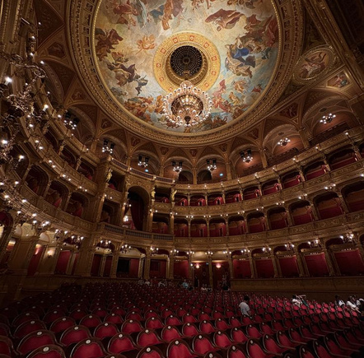

ABOUT US
AdventureBox was founded in 2024 with the goal of offering experiences that enrich life with memorable moments. Our company aims to provide special and unique gifts for all those who want to give something truly personal and lasting to their loved ones, friends or even business partners.
AdventureBox offers a variety of programs, adventures, workshops and crafts to satisfy the needs of all interested parties.

Slide 3

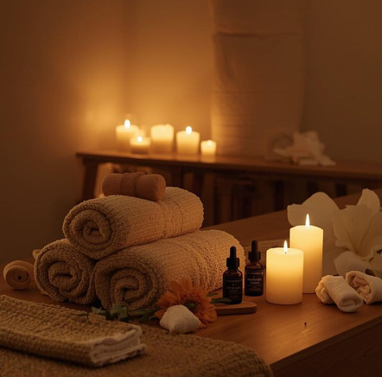
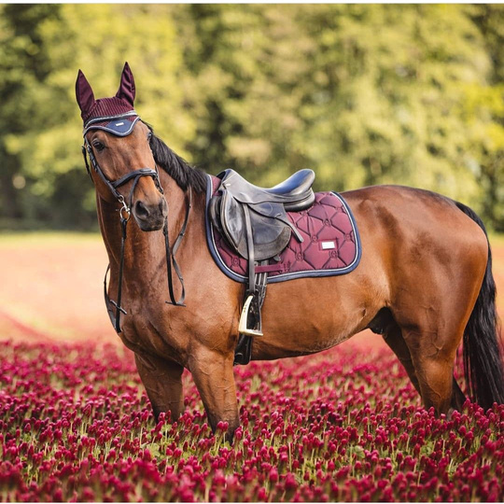
OUR PACKAGES
Try one of our packages!
  Adrenaline
  Travel (Hungary and worldwide)
  Family
  Gastronomy
  Spa
  Hobby
  Culture
  VIP
Choose the most suitable pastime for you!

Slide 4





CONTACT
+36-96/312-135
elmenybox@gmail.com
elmenybox.webnode.hu
9022 Győr, Bisinger sétány 32.

