Slide 1

Kosta Mobile GmbH

Slide 2
ACTIVITY
We, Kosta Mobile GmbH, are a dynamic company specialized on the distribution of modern electronic devices. Our product range includes a wide variety of high-quality items – from smartphones and headphones by leading brands such as Apple and Fairphone to accessories such as phone cases, charging cables, and much more.

Slide 3
COMPANY DETAILS
Kosta Mobile GmbH
Pernerstorfergasse 77
1100 Vienna
kosta2361@uebungsfirmen.at
https://kosta.bhakwien10.at
+43 1 602 5191 - 510

Slide 4
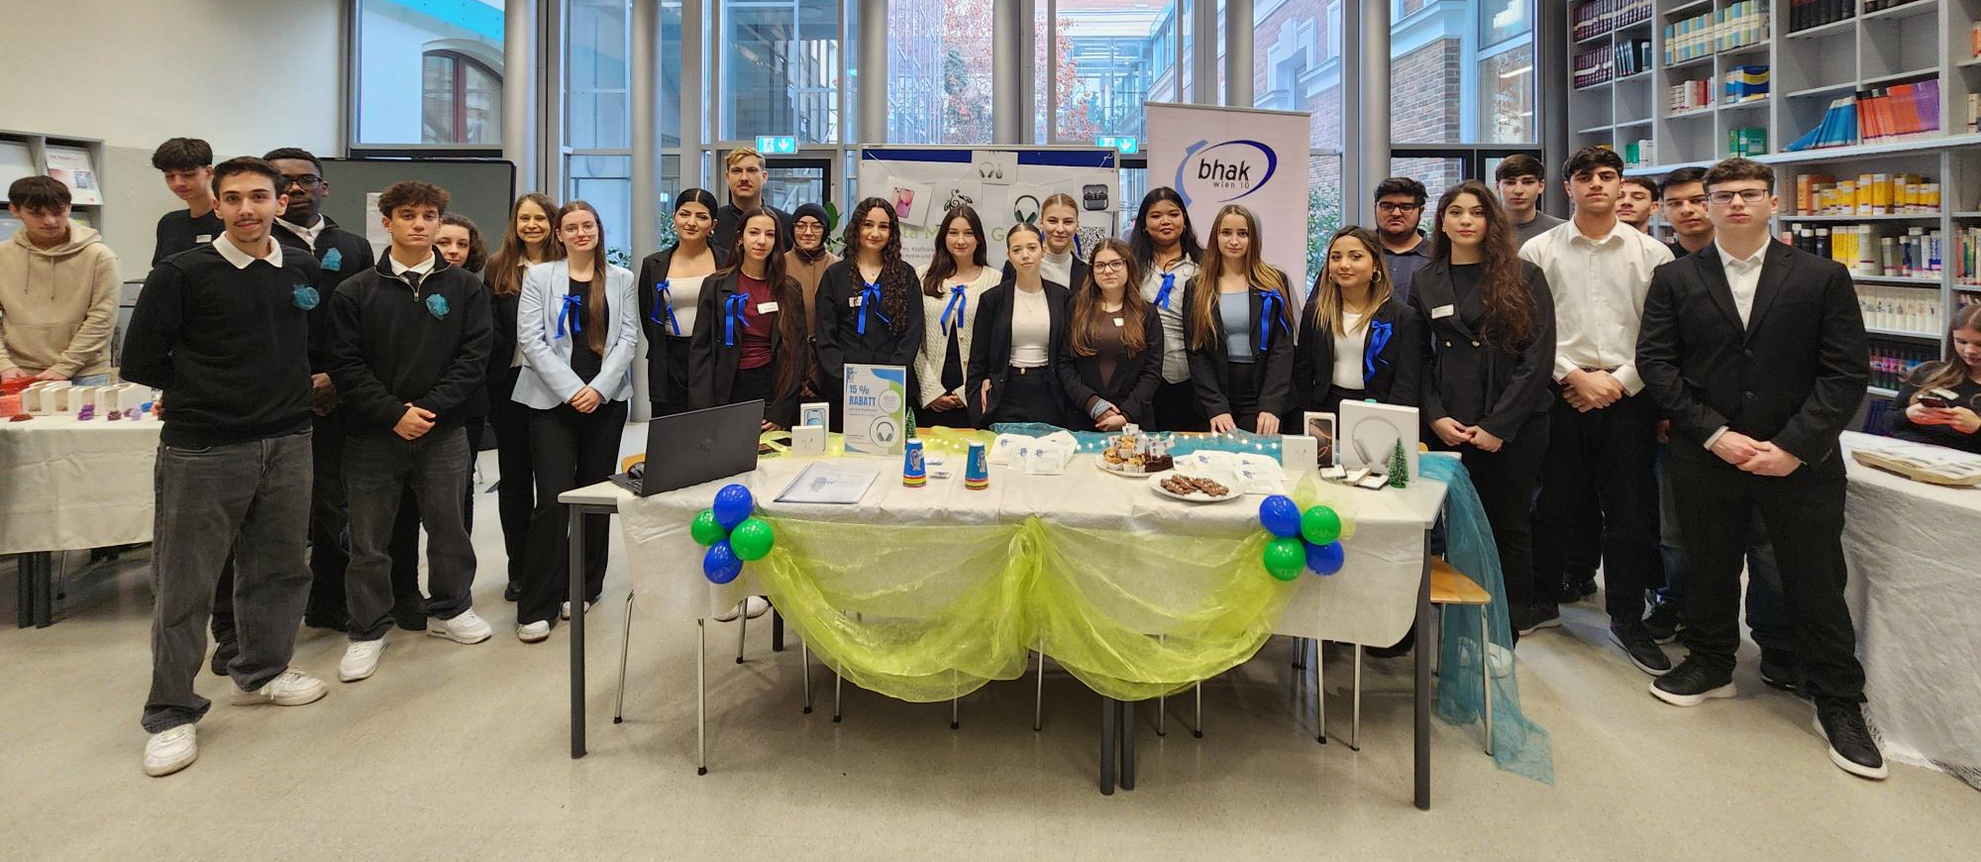
OUR TEAM

Slide 5
Smart technology
sustainable choices

