Slide 1




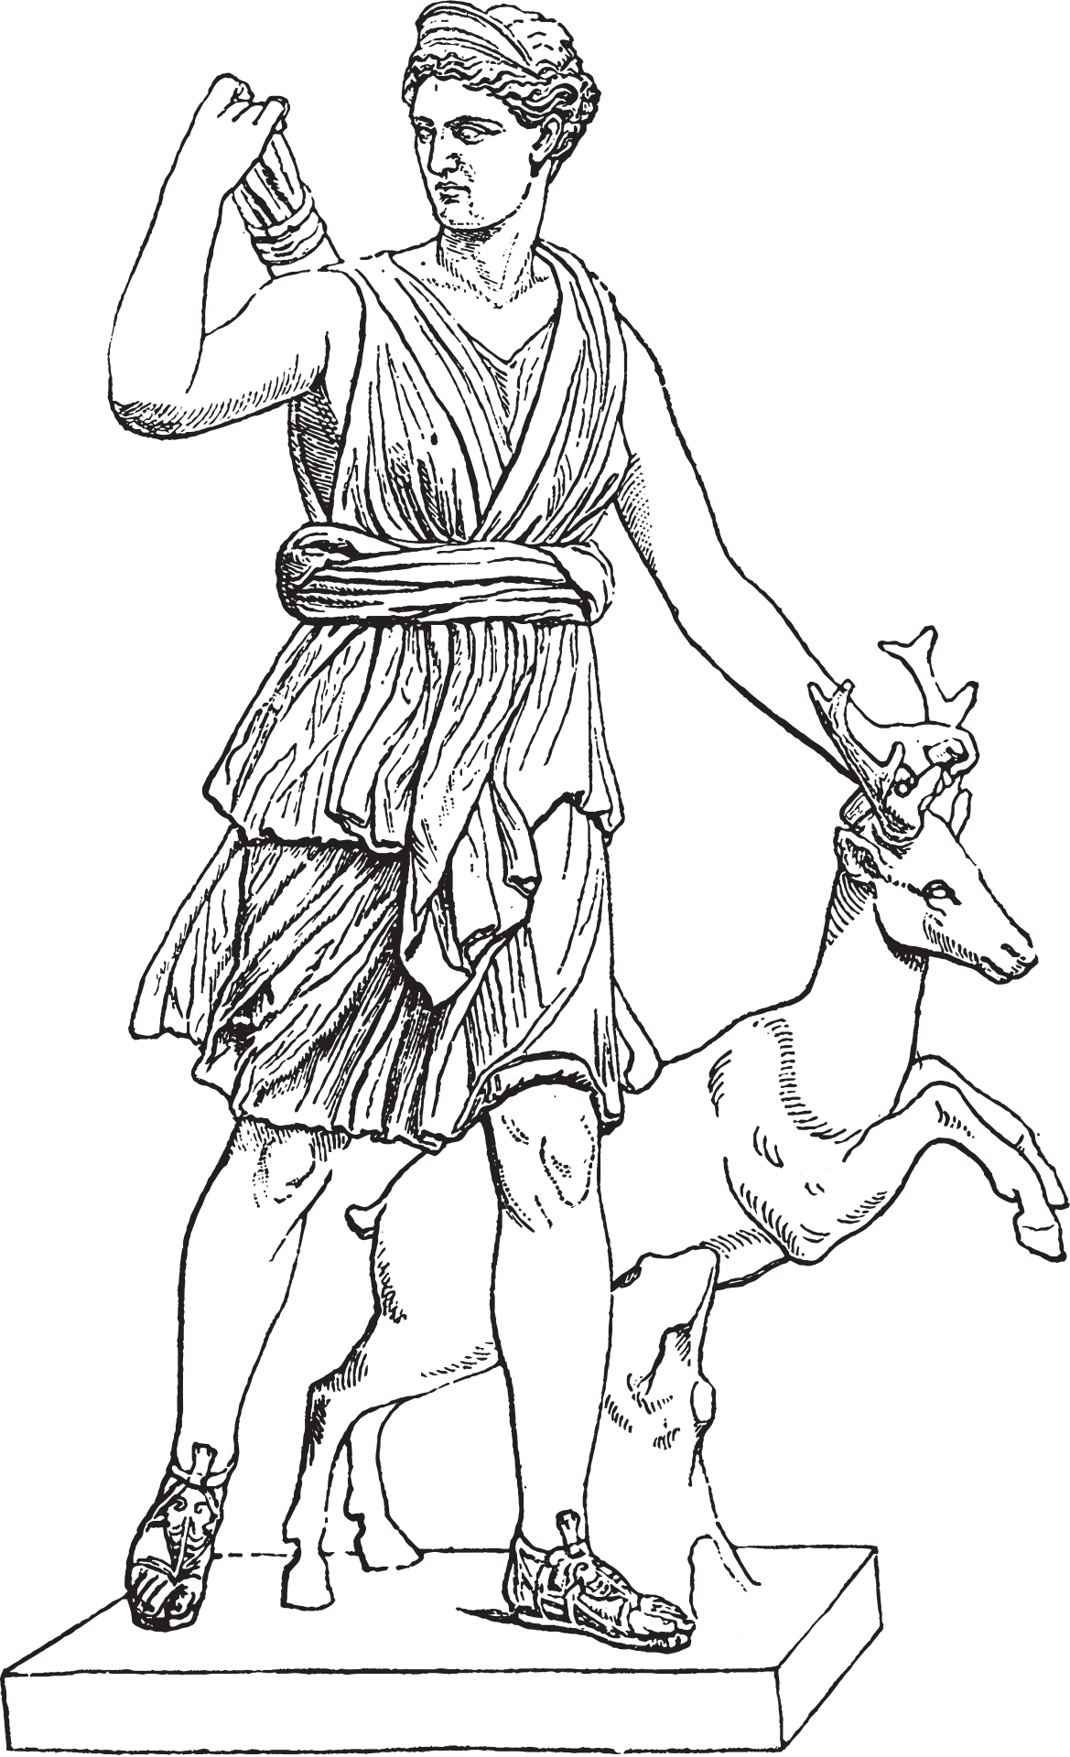

Hermes Garden
Making the events that speak your story

Slide 2

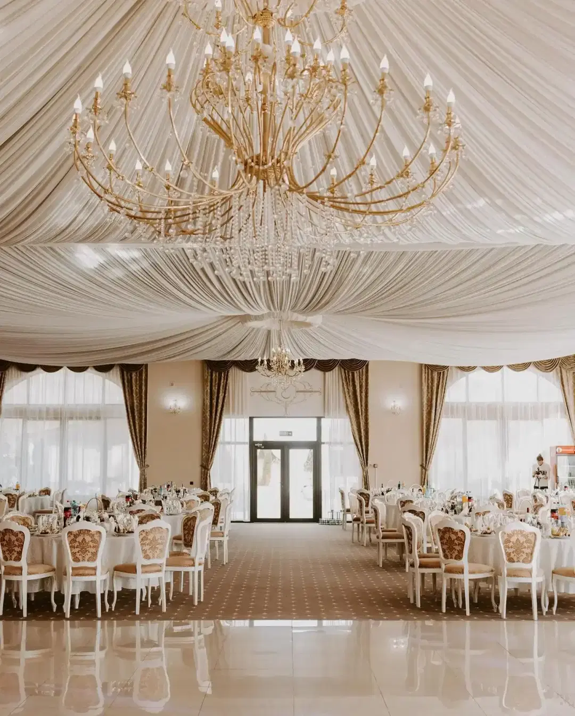
Hermes Garden Events
Our desire is to offer you elegance and refinement at the highest level.
The company Hermes Garden S.R.L, founded in 2025, specializes in event planning and management.

Slide 3

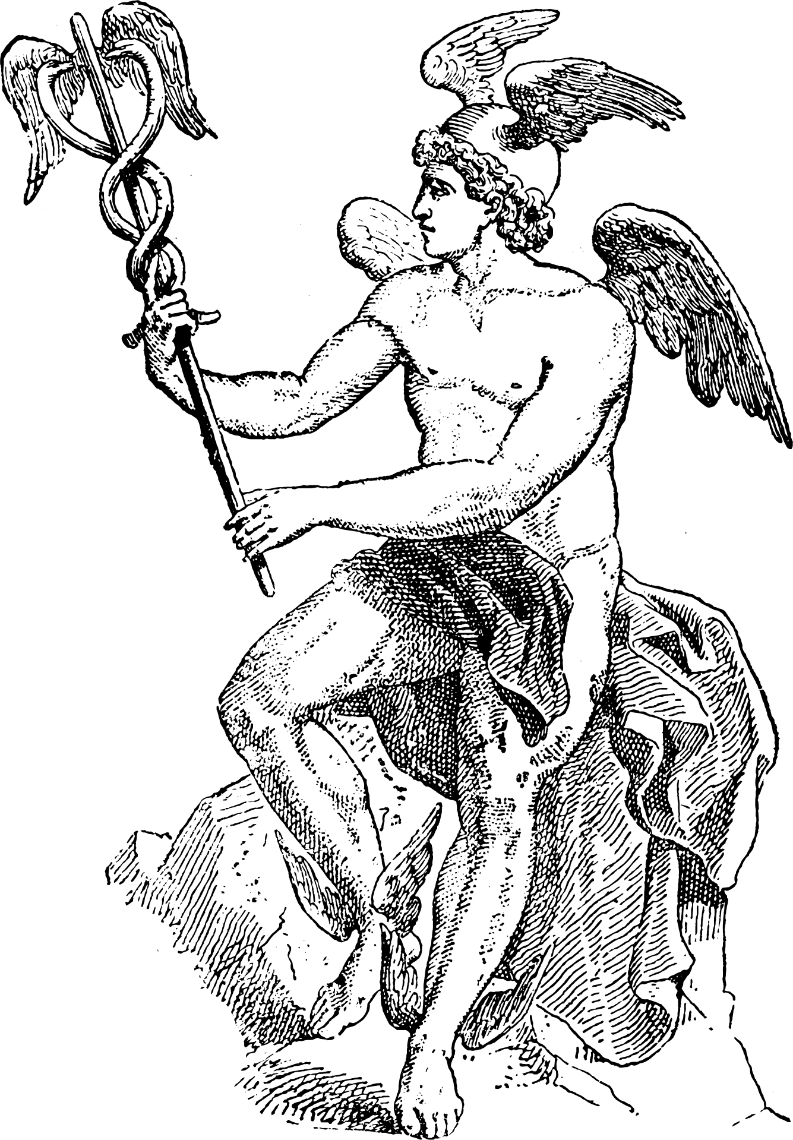

We rely on the latest trends in event organization, and we also focus on the requirements of our clients.
What sets Hermes Garden apart from other event planning firms is our attention to detail and personalized approach to each event.
We take the time to get to know our clients and their unique needs, ensuring that each event is tailored to their visions.

Slide 4

Our team
Dobrescu Alexandra
Secretary and Marketing Manager
Banu Radu
C.E.O
Otobicu Andrei
Financial Manager
Cotae Alexandru
Dezign manager

