Slide 1









Slide 2




Products & Services
1. Fine Dining Restaurant (Michelin Inspired)
7–12 course tasting menus
wine pairing & dedicated sommelier
modern recipes with French and Japanese influences
themed experiences (Chef’s Table, Dining in the Dark)
2. Urban Cafe & Co-Work
specialty coffee
individual spaces and communal dining
high-speed internet
cowork pass and meeting corners
3. Premium Pastry Shop (separate building)
french croissants
handmade products made daily
sourdough breads • fine desserts • bagels
4. Events Salon (at the back, completely soundproof)
250–300 people
staging, lights, professional sound
5. Future expansion: Hotel&Spa Hermes
premium rooms
direct access to the restaurant
rooftop pool & sky bar

Slide 3

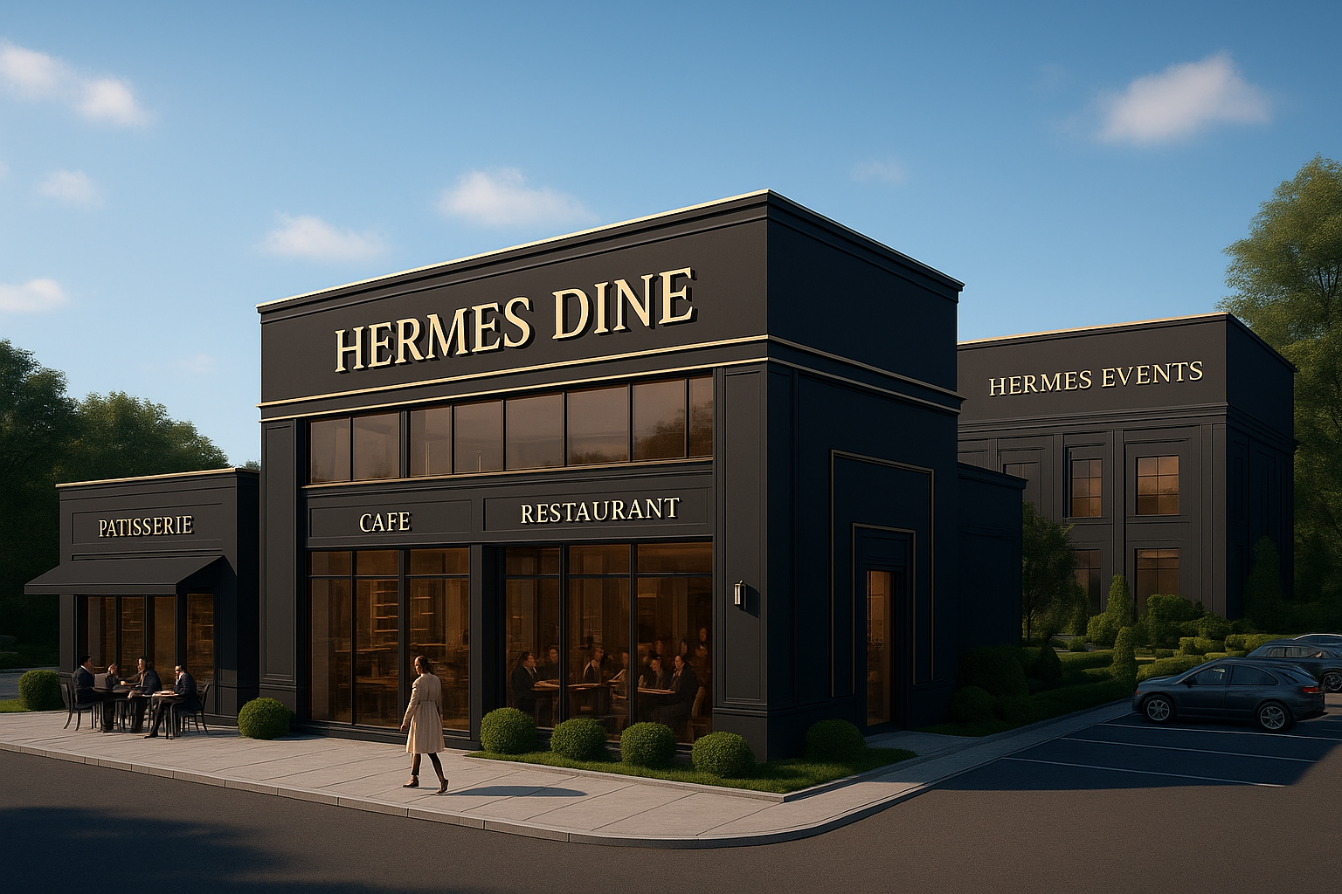

Our business
Hermes Dine is a unique integrated restaurant concept, bringing all types of culinary experiences under one roof:
WWWWWWWWWWWWWWWWWWWWWWWWWWWWWWWWWWWW
Cafe & lounge – modern space for studying, relaxing and socializing
Luxury restaurant – gourmet menus inspired by international cuisine, with fine dining services
Event hall – space dedicated to private parties, proms, weddings and baptisms
Pastry & baguette shop – fresh daily products, available for takeaway
Our vision: To become the first gastronomic complex in Romania that offers a complete experience, from a simple coffee to a complex event.
CAEN Code- 5610
WWWWWWW
Boulevard Mircea Eliade nr. 13, Sector 1, Bucharest – Aviatorilor Zone

Slide 4



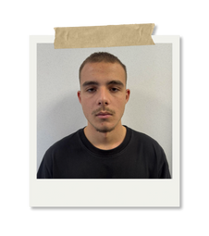
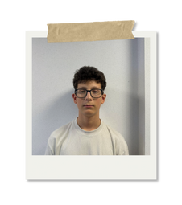
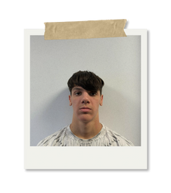
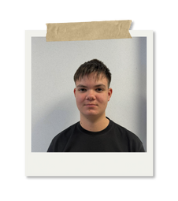
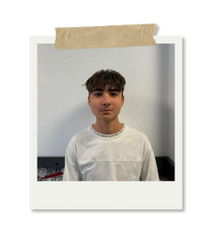

Management Staff
Chief Executive Officer
Mierlita Alexandru
CEO
Chief Operating Officer
Marcu David
COO
Chief Marketing Officer
Chief Technology Officer
Scutariu Darius
CMO
CFO
CTO
Marai Radu
Chief Financial Officer
Sloata Patrick

