Slide 1





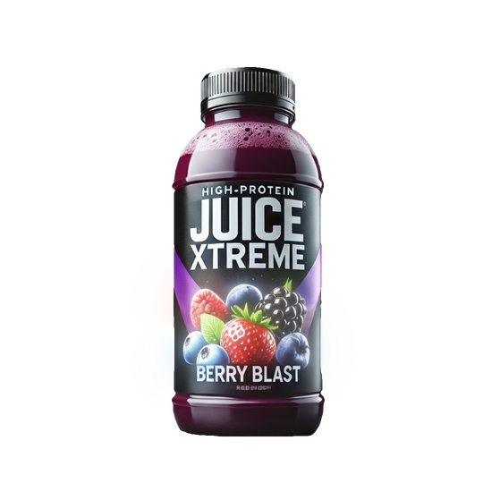

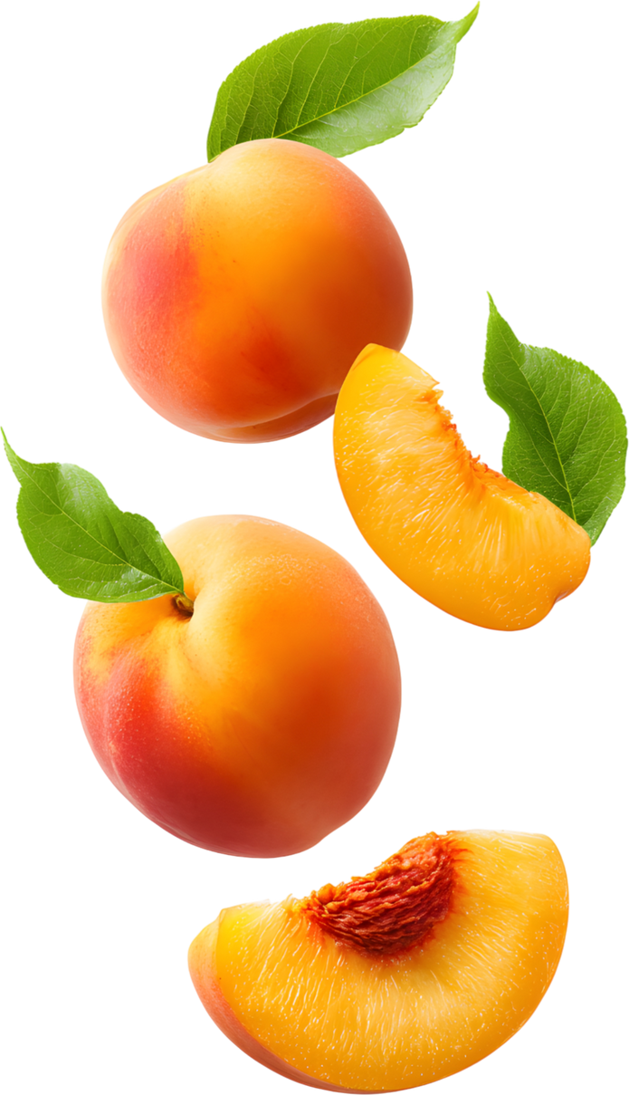

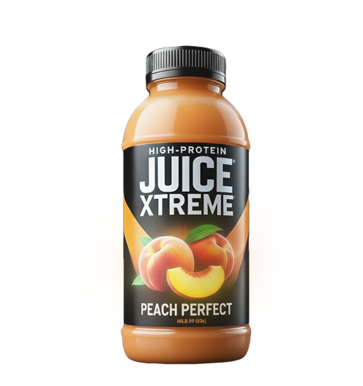
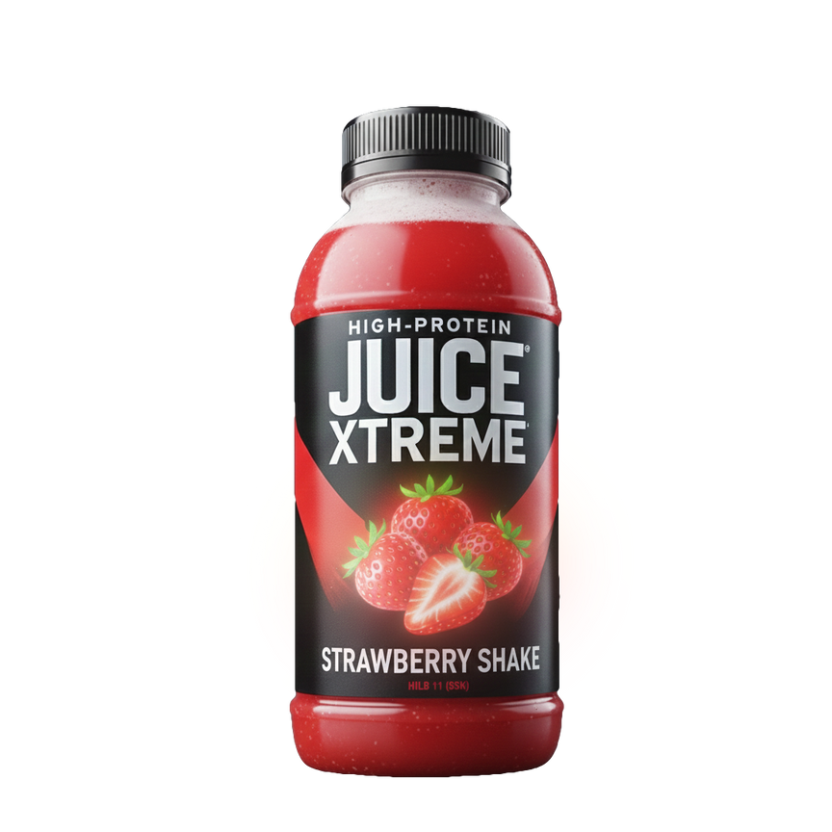
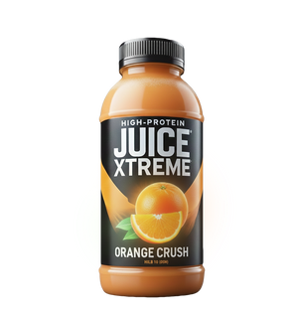
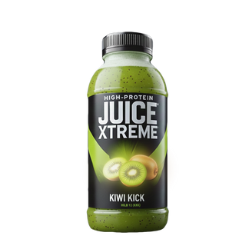
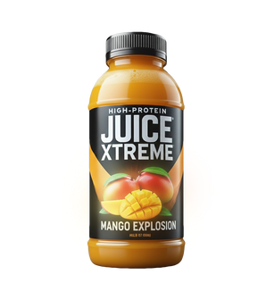
JUICE
XTREME
Maximum energy, intense taste, limitless performance!

Slide 2

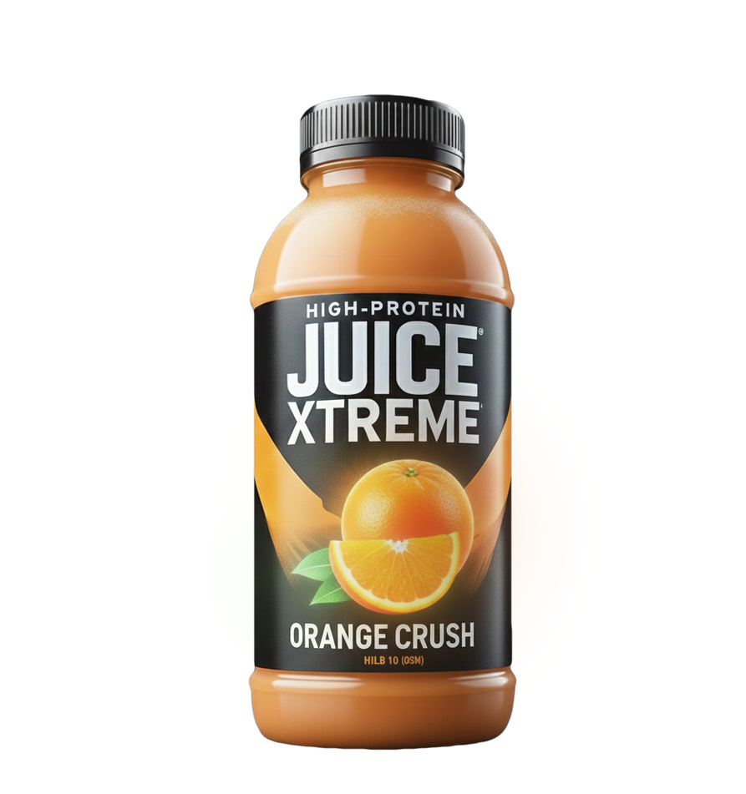

ABOUT OUR ACTIVITY
At Juice Xtreme, we believe that healthy nutrition should be within everyone's reach. That's why we have created a range of natural protein juices, perfect for an active lifestyle. Our products combine fresh fruits, plants, high-quality proteins, and carefully selected ingredients, providing energy and essential nutrients in every sip.

Slide 3





29 MÂNTULEASA STREET,
BUCHAREST, SECTOR 2
@JUICE_XTREME
@JUICE-XTREME
JUICEXTREME.OFFICE@GMAIL.COM +40 733 238 688
DETAILS

Slide 4
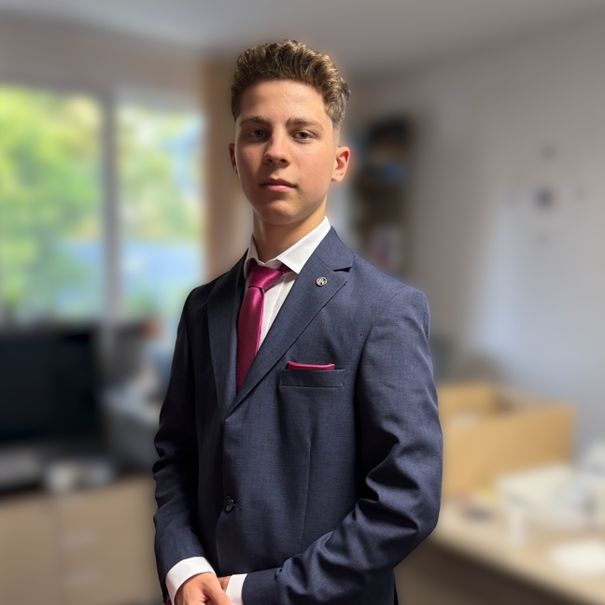
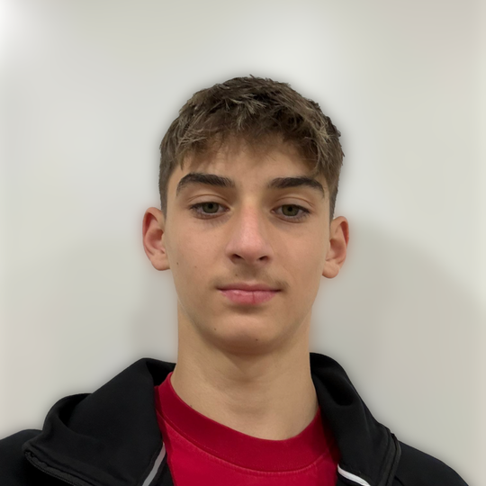
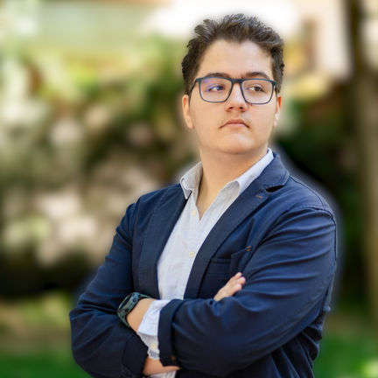
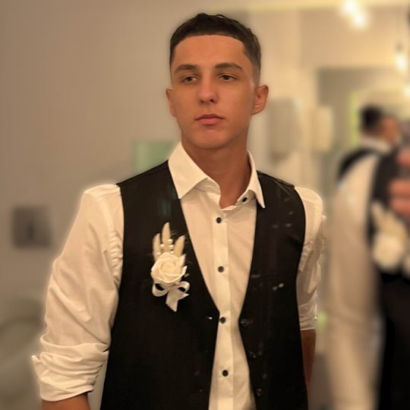
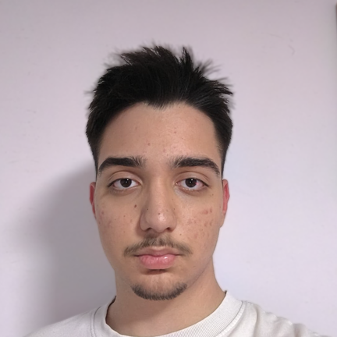
OUR TEAM
FOUNDERS
vasile
manea
robert
Arian
distribution
manager
marketing
manager
finance
manager
enache
robert
negru
savescu
eric
mario

